Slide 1
Topic: Israel-Palestine Conflict
Presented By: Muhammad Hamza Farooq
Registration # 200901019
Submitted to: mam Madiha khan

Slide 2
Introduction:
In 1947, when Israel and Palestine both states came into being, this was seemed to be the conflict between two states. Basically the land of Palestine was under the rule of Ottoman Empire as that empire was ruling about 3 continents. According to 1878 Ottoman record, there were about 87% Muslims, 10 % Christians and only 3% Jewish people were settled on the land of Palestine. Then what actually happened that number of Jewish people came from all across the world and started to settle on the land of Palestine and United Nations in 1947 make the state of Jews on Palestine land.
Today, In this presentation I will present that what is the actual history, what was the actual reason Jews want to settle over their, why United Nations gave them the right to settle over there and what are the consequences Palestinian people still facing today.

Slide 3
History:
In the end of 19th century, a Jewish journalist gave the concept of Zionism that Zionism is not a religion, it’s a name of nation and their should be a free nation for Jews. After this, the entire world started talking about that Jews have the right to have an independent country.
In 20th century, world war 1 started in which France and England have war with Germany. Ottoman Empire was supporting Germany. When war was still in progress, In 1917 England sent a declaration letter to Jews that they will help them to settle on the land of Palestine after winning world war 1.
As Britain’s are very clever, In 1916 they already told France that after winning the war, they will occupy and took control on the land of Palestine.

Slide 4
Also, 1n 1915 Britain's promised to Sharif Hossain (ruler of Makkah) that if they support Britain's against Ottoman Empire, they will give Sharif Hossain the right to rule land of Palestine.
The war ended, Britain's won the war and Ottoman empire was separated. Britain's only facilitated the Jewish people to come and settle at the land of Palestine.
Now the reason Jews wants to settle only on that land was Jerusalem (a city in Palestine). Jews think that the rise of there religion begin from this city, so that is why they want there nation to be developed over their.

Slide 5
So when Britain’s started facilitate Jews, numbers of Jews from all around the world migrated to the land of Palestine. So from 1929 to 1939, about 320,000 Jews settled over there. As Jews started to settle over there, they want that land to be their separate nation, but the Palestine people basically Muslims started the rebellion against Britain’s but their rebellion against them was being pressed down by Jews and Britain’s. Later, Britain’s issued a notice that after 10 years, there will be a separate state for both Jews and Muslims on land of Palestine. Both Muslims and Jews are not happy on that decision.
In 1945 Britain’s gave this issue to United Nations and asked them to solve the partition issue between Palestine and Israel.

Slide 6
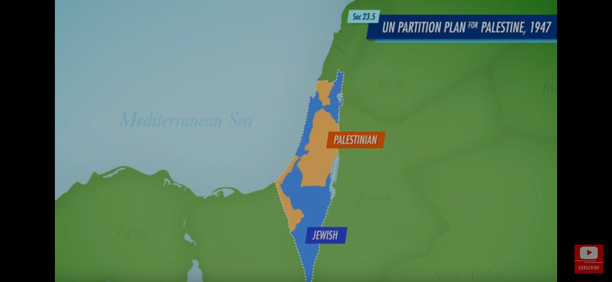
So in 1947, two states were formed. One named as Palestine and second as Israel as shown in the figure below:

Slide 7
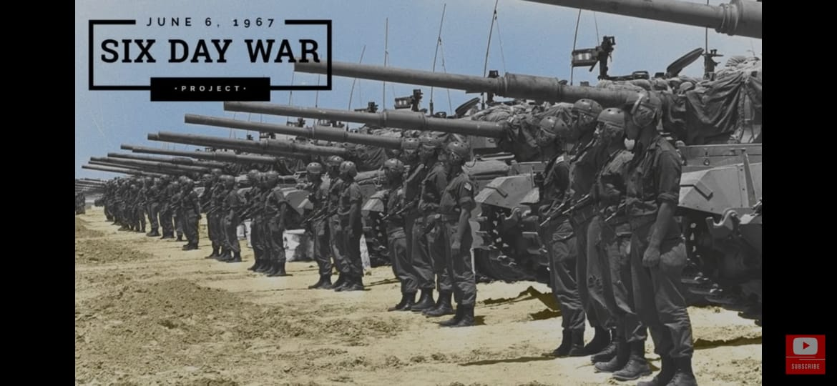
In 1948, the war was started between Arab countries and Israel and in this war Israel were victorious. After that war, Israel occupied about half of the Palestine’s land which makes Palestine completely disappear from the world map. Gaza Strip was under control of Egypt after that war. Next eighteen years remains the same. Then in 1967 there is another war started which is known as 6 days war .

Slide 8
6 day war was basically Israel war with Syria, Egypt and Jordan. In this war not only Israel occupied Gaza Strip but also west bank.
In 1978, Arab-Israel conflict came to an end and Palestine-Israel conflict started. Palestine started fighting for their rights. As west bank and Gaza strip which are the only places remained for the living of Palestine people, Jews started to settle at those places too. About 350,000 Jews were settled in west bank and about 200,000 were settled in East Jerusalem which is completely illegal as stated by International Law.
Palestine have a Congregation at that time named as Palestine Liberation Organization (PLO) whose appointed leader at that time was Yasser Arafat. This organization was made at 1964. They attack Israel with their Gorilla Force. In 1993, there was an agreement between Yasser Arafat and Israel’s Prime minister that PLO will accept Israel and in return Israel will accept PLO as representative of Palestine as well as make a Palestine Authority in Palestine due to which there will be peace, prosperity and elections after every 5 years.

Slide 9
That agreement worked for 7 years till year 2000, then in 2000, negotiations between Israel Prime Minister and PLO were failed due to which Israel Prime Minister sent Israel Army troop of about 1000 personnel to Temple Mount. This makes Palestine Muslims furious resulting in a fight/war between Muslims and Israel till year 2005. In between year 2000 to 2005, 3200 Palestinians were martyred and about 1000 Israel personnel's were dead.
In year 2005, Yasser Arafat died and in 2006 Israel started to think that the conflict between them will never settle so they will try to manage the conflict.
Now in 2006 when election took place in Gaza, Hamas came into power. They are known for suicide bombing and attacking on Israel. They also helped in making schools, providing medicine and aid to injured ones. From 2006 till now, nothing has changed.

Slide 10
What’s happening in Palestine right now:
In Palestine, Israel is bombing Gaza and killed about 150+ people and counting. This all started from Sheikh Jar rah, Israeli settlers started stealing Palestinians homes from decades. When Muslims Palestinians started to protest against them, Israel sent their Armed force to stop the protest by arresting protestors and spraying skunk water on them.
When they can’t stop the protest, Israel started to attack on AL-AQSA. In the Holy month of Ramadan, Muslims are praying in AL-AQSA, Israel force entered AL-AQSA and started to shoot rubberized steel bullets and stun grenades on Muslims. Israel is attacking every single second and injuring thousands of Muslims including women and children.

Slide 11
This lead Muslims in Sheikh Jar Rah , West bank and in Gaza to protest against Israel. Israel force again started throwing grenades and firing rubber bullets on Muslims protestors.
Hamas warned Israel to not attack our Holy place AL-AQSA but Israel force again attacked and took control on all over AL-AQSA. As a result Hamas attacked on Israel resulting only one injury of the Israel Armed force.
Israel, in result started bombing in Gaza, destroying Mosques, buildings, schools, homes and hospitals. Not only Israel Army is destroying Palestinians, Israeli civilians are also killing and destroying Palestinians homes and properties.

Slide 12
All Muslim countries became furious on the behavior of Israel. Countries like America, India and United Kingdom are saying that Israel have a right to live in their country, they have a right to kill innocents and they also say that they support Israel.
Muslims all over the world starts protesting against the Israel so that Palestine will be free. This may take a while but the day will come when Palestine will get their rights. One day Palestine will be an independent and peaceful country.

Slide 13
Thank You!

